Slide 1
The Impact of Technology on Sleep Among Different Age Groups
2023
Data Science
Eglė Jasevičiūtė
Nikita Demin

Slide 2
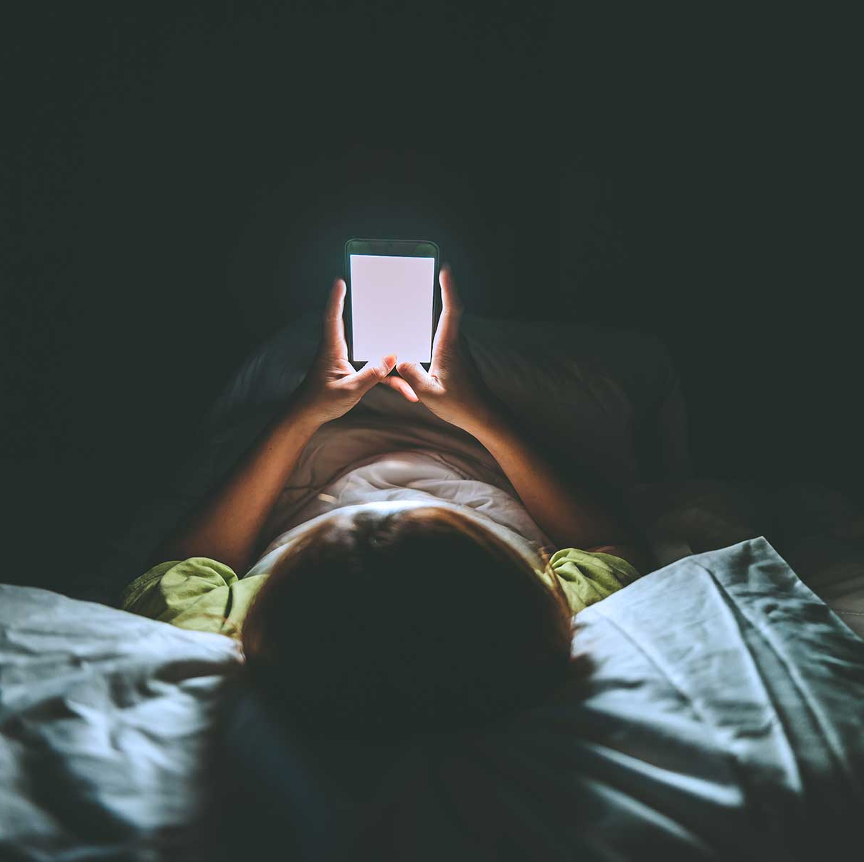
Outline
Introduction
Aim, research questions and hypothesis
Background information
Methods
Results
SWOT/PESTLE
Conclusion

Slide 3
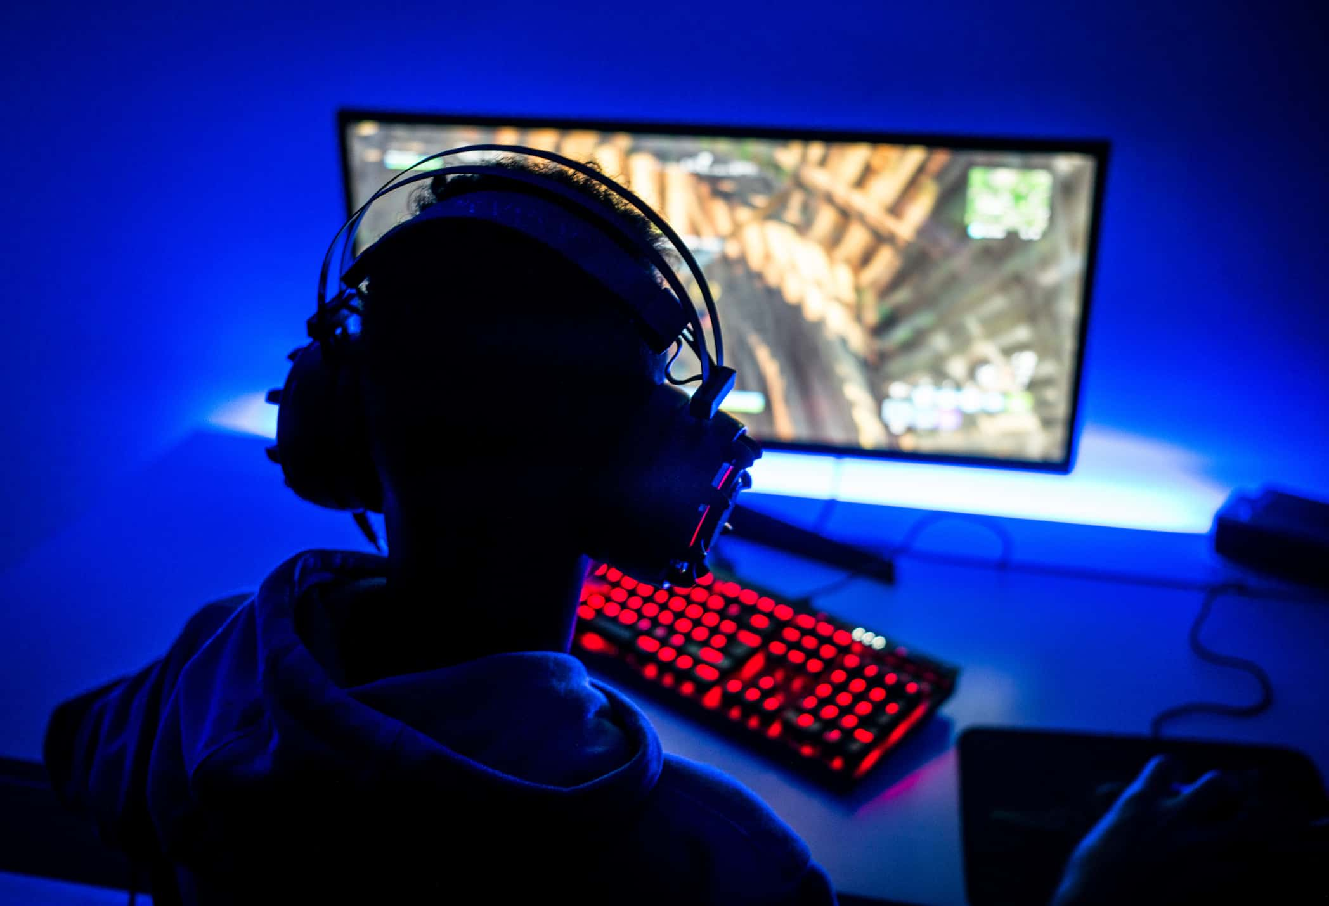


Introduction

Slide 4
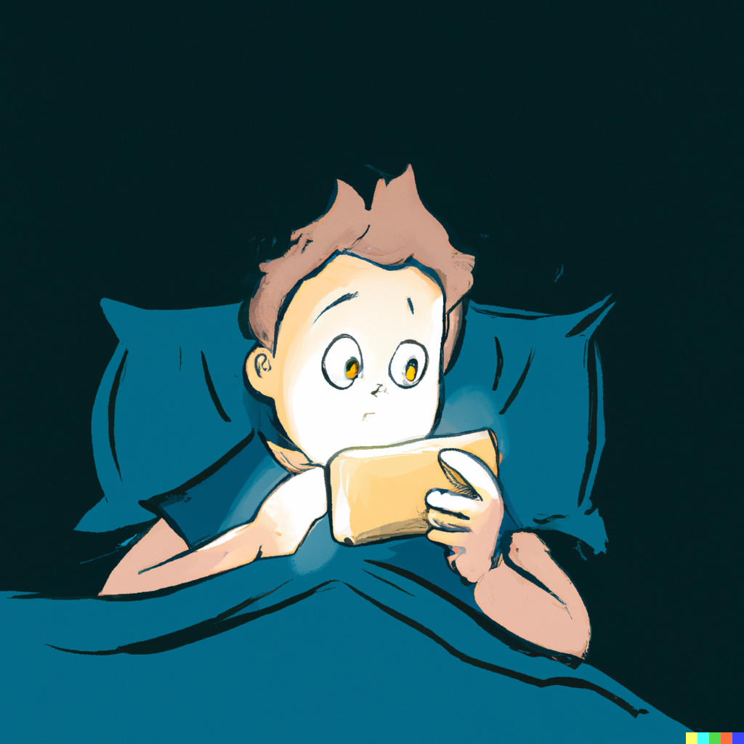
Aim
The main aim of this study was to examine the impact of technology on sleep quality.

Slide 5
Research questions
How does technology affect sleep? Does it even affect it?
Does the impact that technology use has on sleeping patterns vary between different age groups?

Slide 6
Hypothesis
Increased technology use, especially before sleep, will be linked to negative effects on sleep quality and duration.

Slide 7
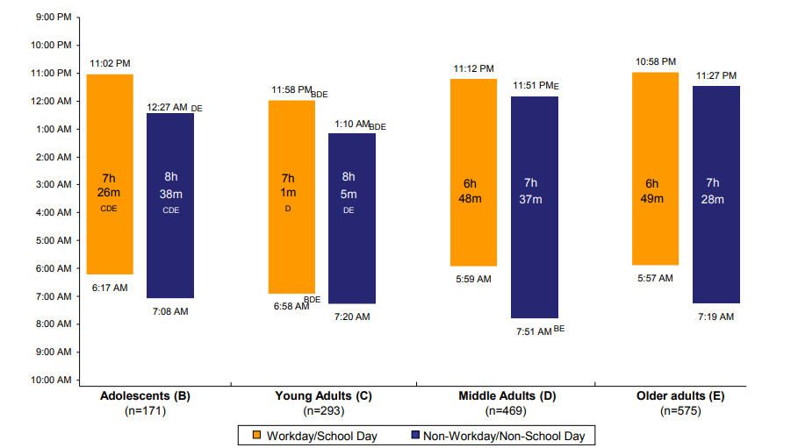
Background information
Fig.1(Self-reported sleep habits on weekdays and weekends between adolescents (B), young adults (C), middle adults (D) and older adults (Michael Gradisar, p. 5)

Slide 8
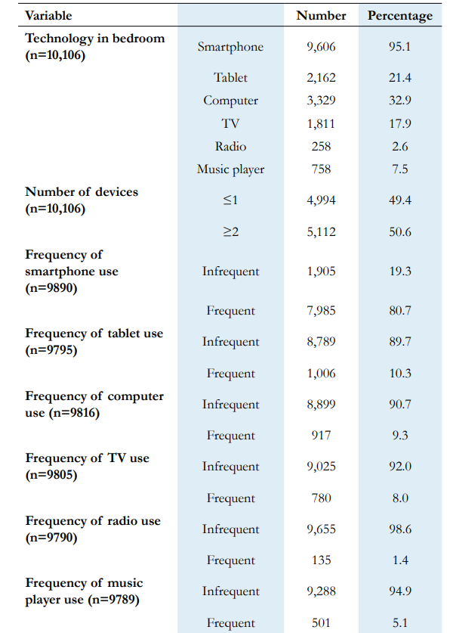
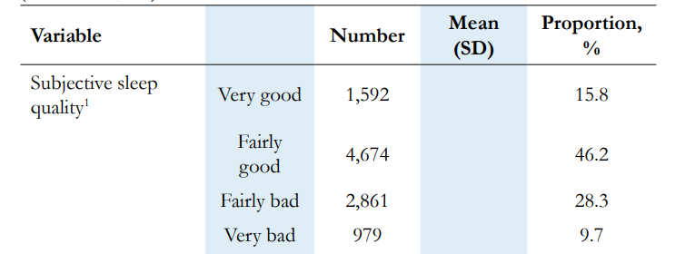
Background information
Table 3. Bedtime technology use by the survey respondents (total n=10,106). Frequency of electronic device use was binarized into “infrequent” (never, rarely, or a few nights a month) and “frequent” (a few nights a week, every or almost every night).(Saad Mohammed AlShareef, p.4)
Table 2. Prevalence of sleep-related parameters in the survey respondents (total n=10,106).(Saad Mohammed AlShareef, p.3)

Slide 9

Methods
Online survey
165 participants
Three age groups: under 18, 18-34, over 34
Open-ended and closed-ended questions (e.g. How much sleep do you get on average?)
Calculating percentages

Slide 10
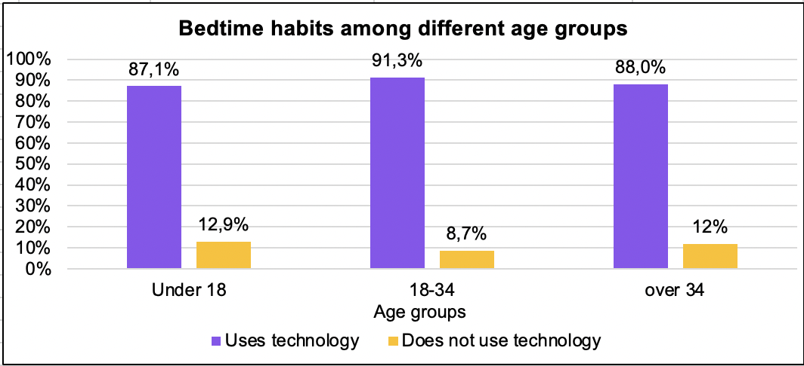
Results
Fig.1

Slide 11
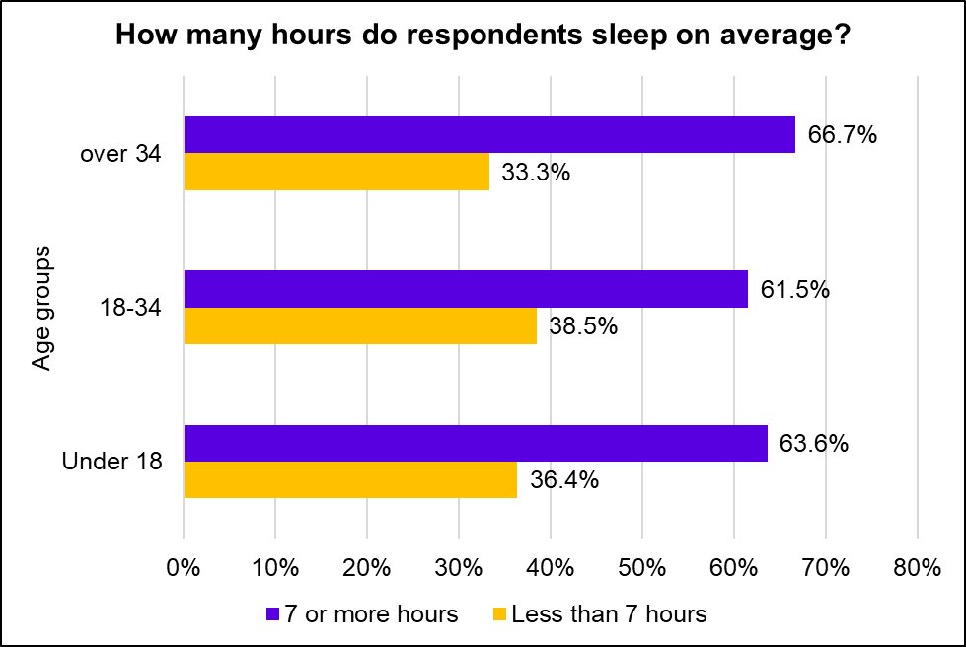
Results
Fig.2

Slide 12
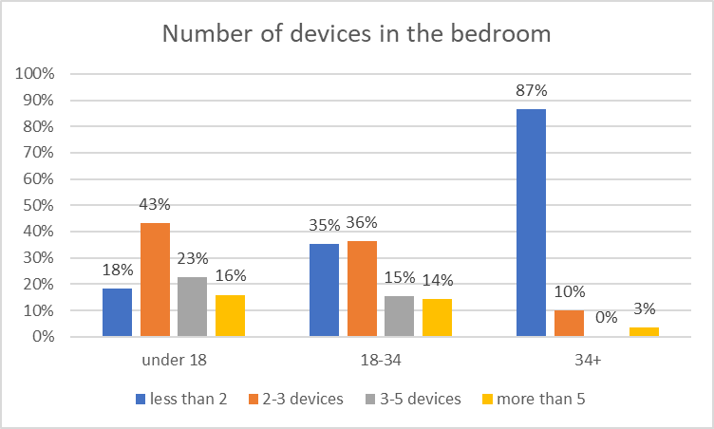
Results
Fig.3

Slide 13
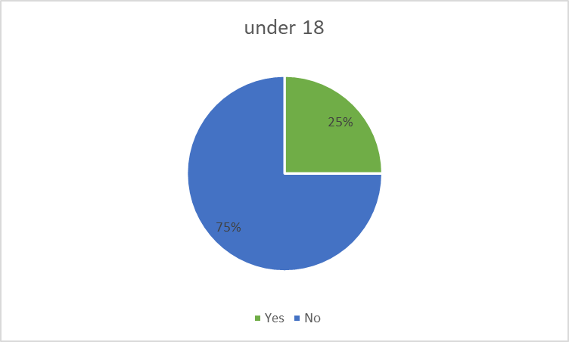
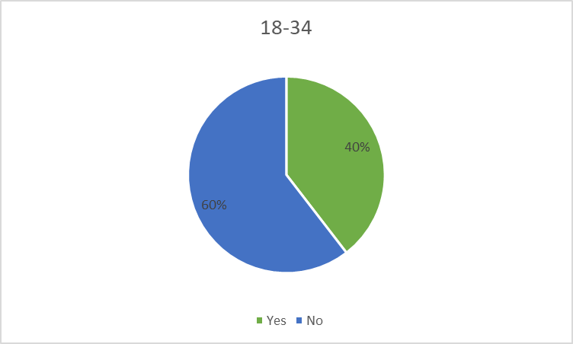
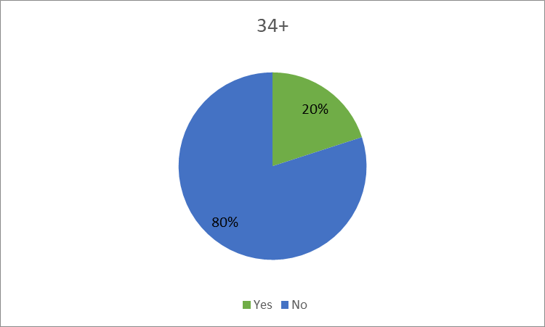
Results
Percentage of people who believe that electronic devices affect their sleep quality
Fig.4

Slide 14
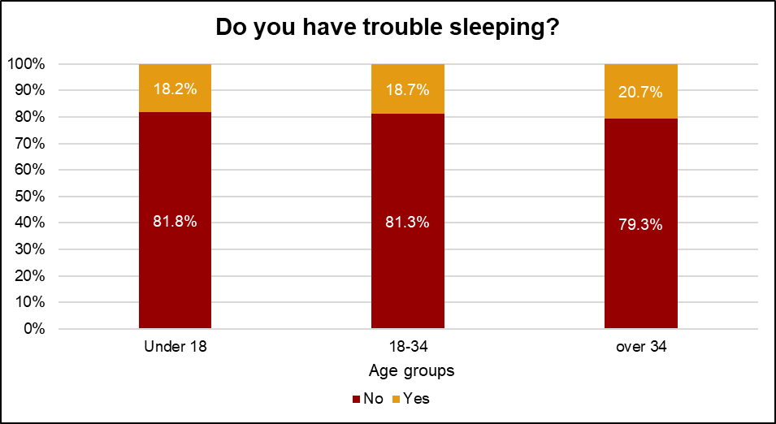
Results
Fig.5

Slide 15
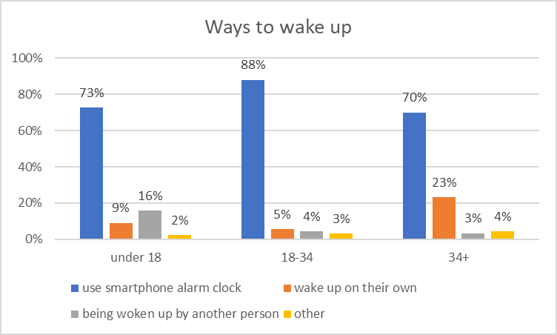
Results
Fig.6

Slide 16
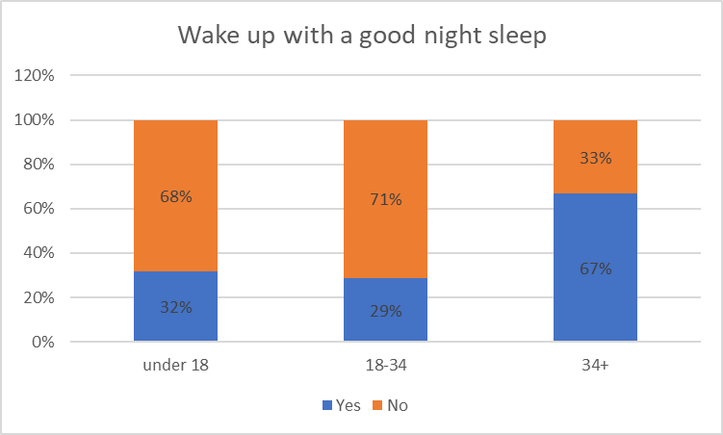
Results
Fig.7

Slide 17
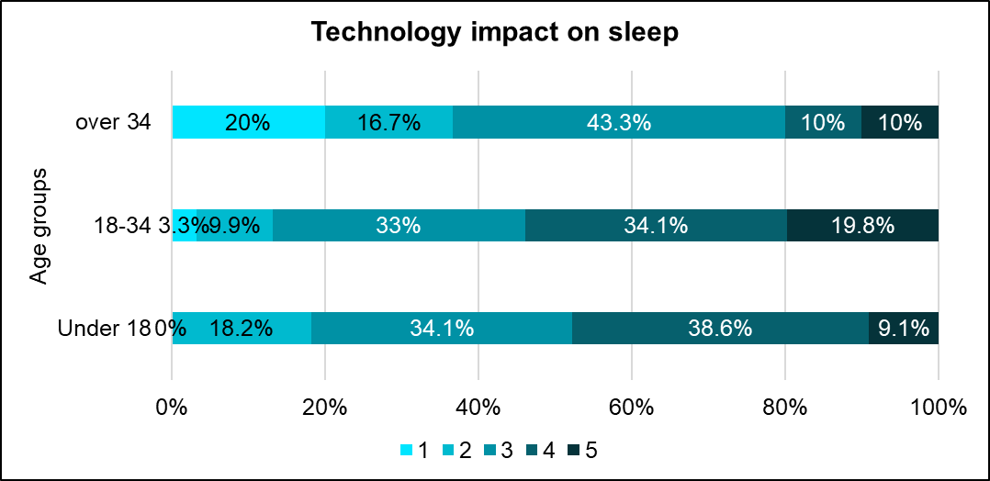
Results
Fig.8

Slide 18
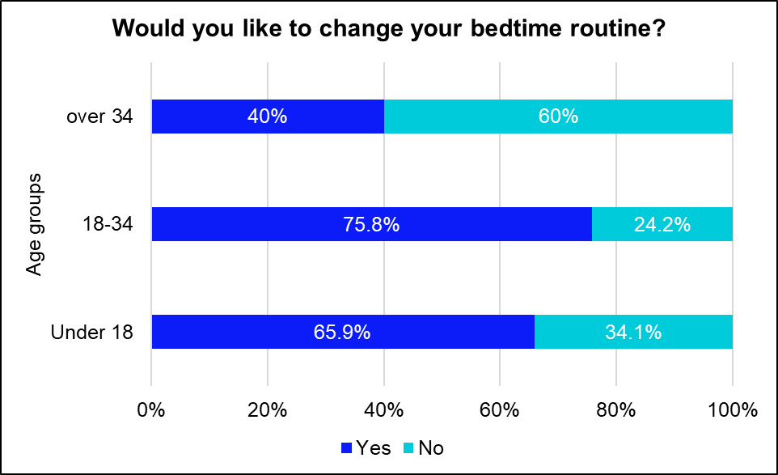
Results
Fig.9

Slide 19

Summary
80% of respondents claimed they do not experience trouble sleeping
Participants generally get enough sleep for their health (7 or more hours a day)
Individuals with higher technology usage did not exhibit a higher likelihood of sleep disturbances
The younger generation believes that technology has an impact on their sleep

Slide 20
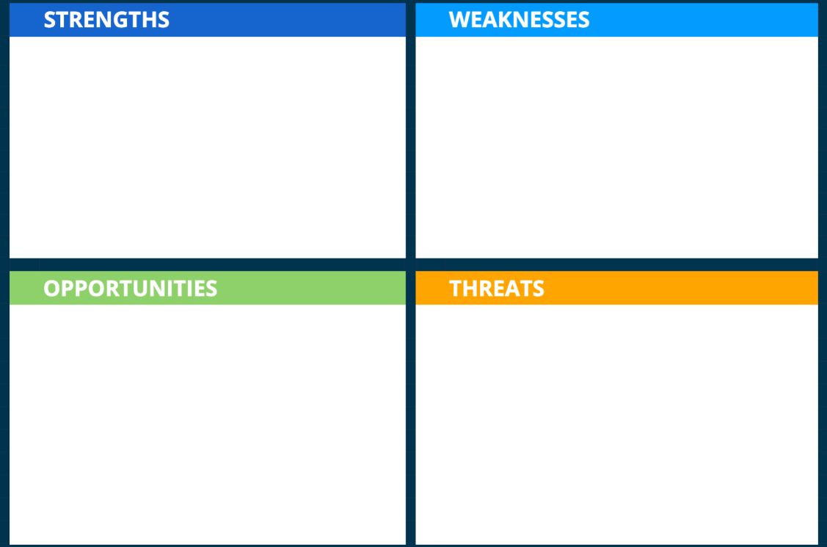
SWOT
Large number of online survey participants (165)
Small amount of data on older people
Study how particular apps affect our sleep quality
Participants may have overestimated their average sleep duration

Slide 21
PESTLE
ECONOMIC
Tired workers bring less revenue for companies.
TECHNOLOGICAL
Electronic devices pose a threat to the wellbeing of users.

Slide 22
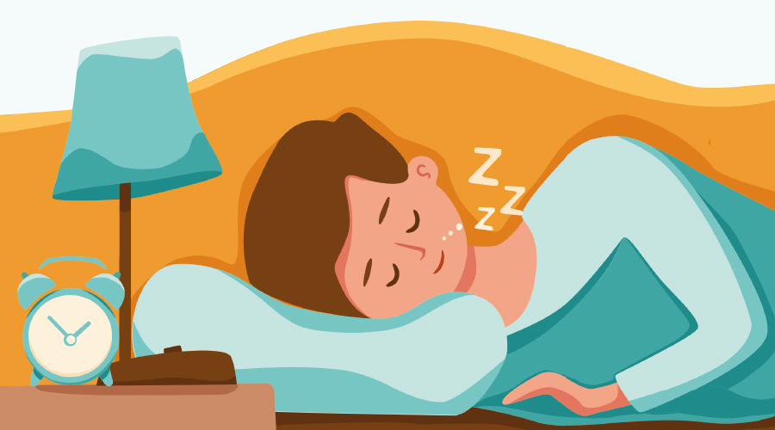
Conclusion

Slide 23
Advice
Create a dedicated space for electronics
Avoid using them for an hour before bedtime
Try to silence notifications
Keep something to read nearby
Resist the urge to check devices when you wake up at night
Reward yourself

Slide 24
References
https://jcsm.aasm.org/doi/10.5664/jcsm.3272
https://www.sciencedirect.com/science/article/abs/pii/S0277953615302458?via%3Dihub
https://www.ncbi.nlm.nih.gov/pmc/articles/PMC8906383/
https://jcsm.aasm.org/doi/full/10.5664/jcsm.5282
https://www.vu.lt/site_files/Skaidri%C5%B3_%C5%A1ablonai/Skaidri%C5%B3_%C5%A1ablonas_VU_pristatymui_LT.pptx

Slide 25
Questions?

